Slide 1
Lambdas and Streams in Java
Meenu Gupta
& Ahmednur Salaad

Slide 2
Topics :
Lambdas and streams in Java.
Streams impact on code performance, using code examples.
Benefits and drawbacks of using lambdas and streams.
Functional programming in Java.
Limitations of Functional programming in Java.

Slide 3
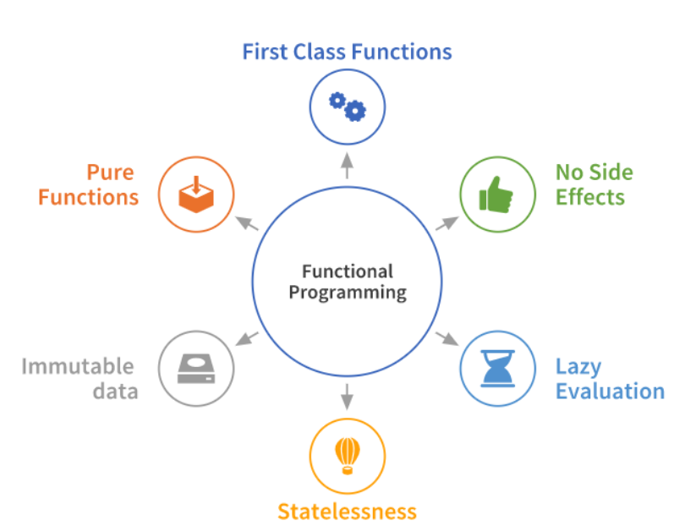
Functional Programming (FP)
FP is a programming paradigm that heavily relies on the use of functions such as :
1. First-class citizens refer to functions in FP as they can be assigned to the variable, passed as an argument to create higher-order functions & return functions as results.
2. No Side Effects is a practice of developing functions that produces the same output for the same input & avoid change to state outside of a function’s scope.
3. Lazy evaluation emphasizes the approach ‘perform operations only if necessary’.
4. Statelessness conveys that functions should only be dependent on arguments and never on outside data.
5. Immutable data concept of FP states that keep value of original variable immutable & create a new variable storing the altered value for the original variable.
6. Pure Functions coding style focuses on creation of functions that can be used for declarative style coding i.e what to do rather than how to do it, hence leading to a more readable code.
Fig 1 : The Functional Programming Paradigm

Slide 4


Lambda’s are similar to methods but they do not need a name. Lambda is basically a short block of code which takes in parameters & returns a value. We can invoke lambda expression by using FI.
Lambda Expression (Lambda)
Key points related to Lambda :-
• These are anonymous functions (without name).
• Useful when we need a short functions that need to used only once.
• Helps to create methods that can be treated as data via assigning lambdas to variables.
• Passed as an argument to other methods like map, filter, sort etc.
• Passed to other lambda which allows for the creation of higher-order functions.
• Return lambdas from methods.

Slide 5
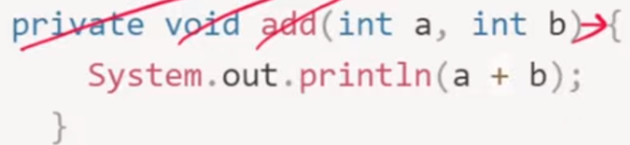

More Lambda Examples : (n) -> {System.out.println(n);} str -> str.length() ; x -> x * 2 Note : if the body has just one argument & one statement then we can remove brackets & curly braces as well.
Lambda Expression Examples:
Steps to turn any function into lambda expression :
Remove:-
a) access modifier
b) return type
c) method name
d) parameter type

Slide 6
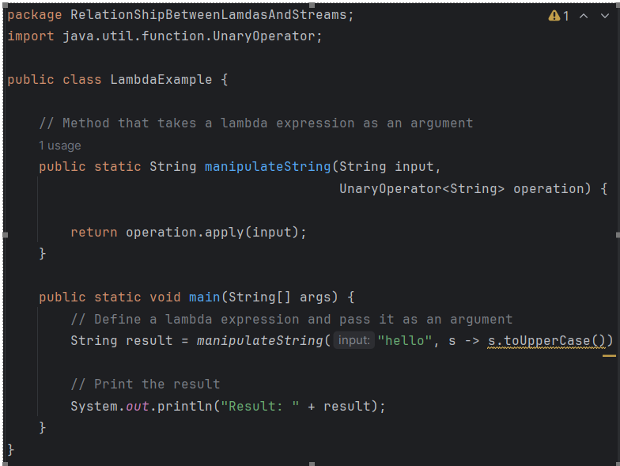
Using Lambda as an argument :
Code files are attached for reference.

Slide 7
Reason behind the compact syntax of
lambda expressions.

Slide 8
FUNCTIONAL INTERFACES

Slide 9
What is Functional Interface ?
Interface having :
exactly one single abstract method (SAM)
but can have any number of defaults and static methods.
Relationship between Functional Interface & Lambda :
In Java, lambda expressions are closely tied to functional interfaces. Lambda expressions provide a concise way to implement single abstract method (SAM).
Lambda Provides a compact syntax for expressing instances of functional Interfaces.
So, technically, you cannot use lambda expressions without functional interfaces in Java.
When you use a lambda expression, you are essentially providing an implementation for
the single abstract method of a functional interface. This eliminates the need to create
anonymous classes explicitly for simple functional constructs.

Slide 10
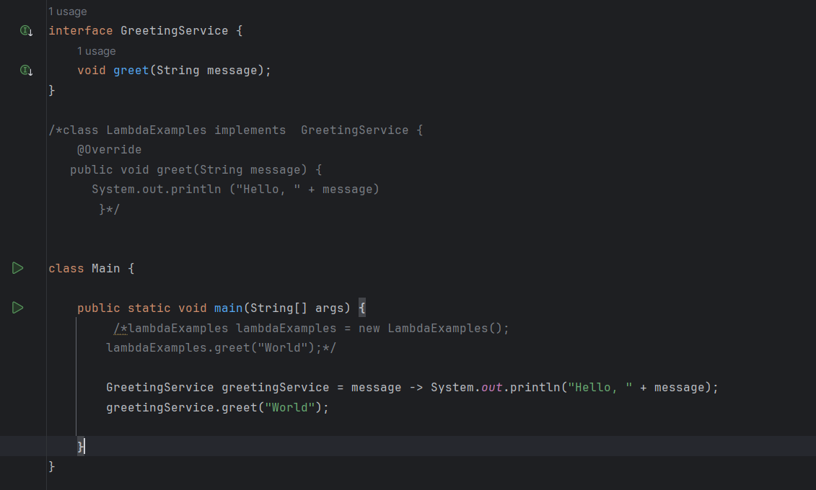
Code Example : Relation between Lambda & Functional Interface :
Code files are attached for reference.

Slide 11
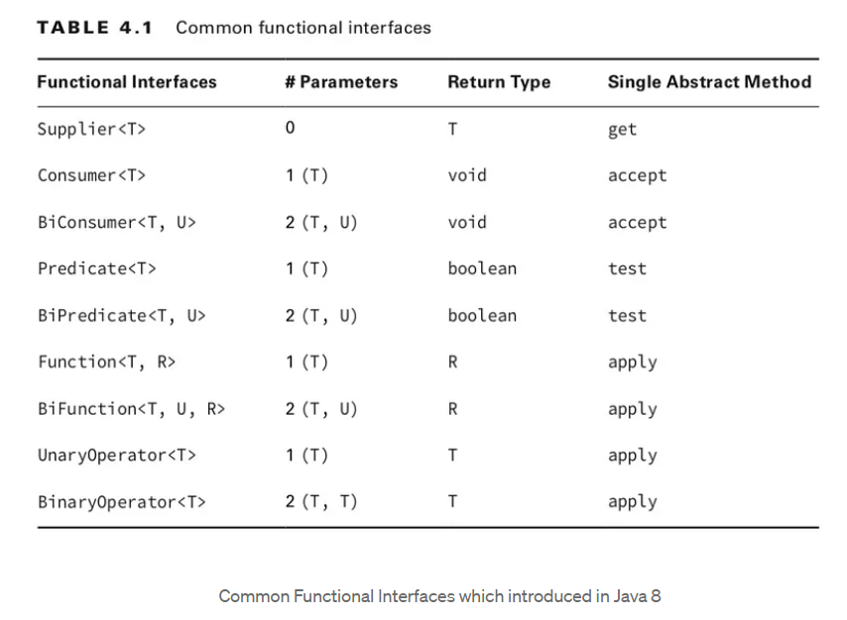
Fig 2

Slide 12
STREAMS

Slide 13
Streams (Sequence of elements/Objects)
Introduced in Java 8, the Stream API. Stream is a sequence of elements/objects that supports various methods (pipelined through computational operations) to produce the desired results.
Key points related to Streams :-
A stream is not a data structure itself, but it operates on a data source (such as collections, arrays, or I/O channels) to process a sequence of elements.
Enables processing of data in a declarative manner.
Focuses on WHAT rather than HOW.
Stream can be processed in parallel or sequentially.
Stream Operations (computational operations) are divided into :
Intermediate Operations
Terminal Operations
Short-circuit Operations

Slide 14
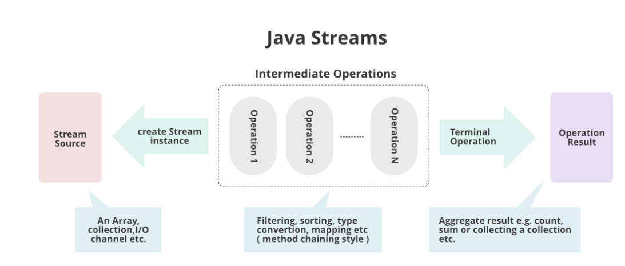
How Streams operate ?
Fig 3 : Java Streams : Operations

Slide 15
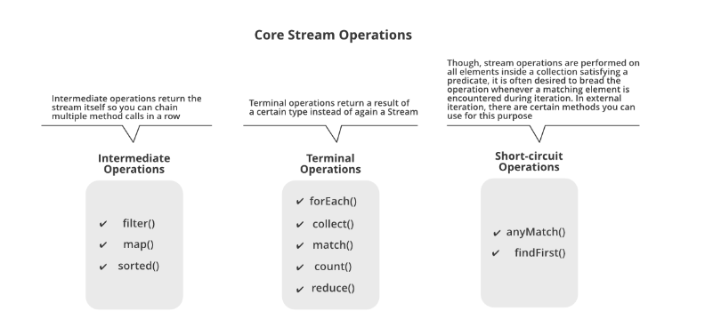
Fig 4 : Core Stream Operations

Slide 16
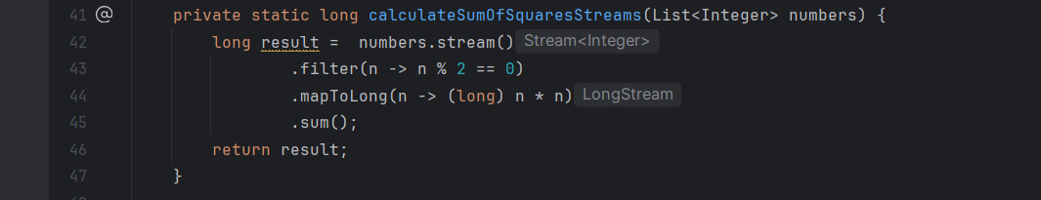
Code example Streams :
Code files are attached for reference.
Notes :
.map(), .filter() and other stream operations are higher-order functions because they take another functions (in the form of lambdas) as an argument.
.filter() use predicate functional interface.

Slide 17
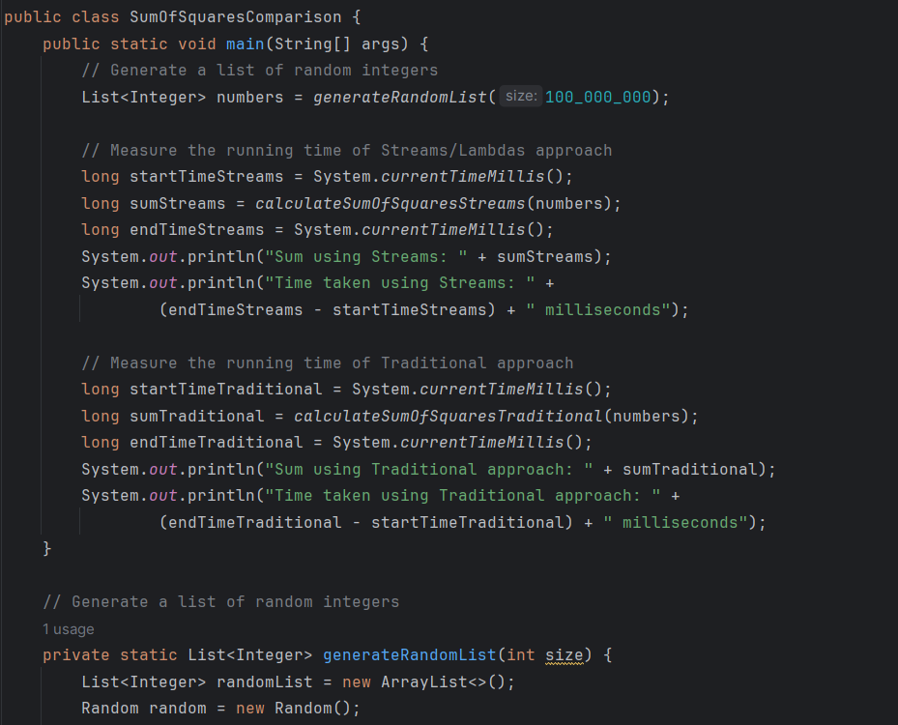
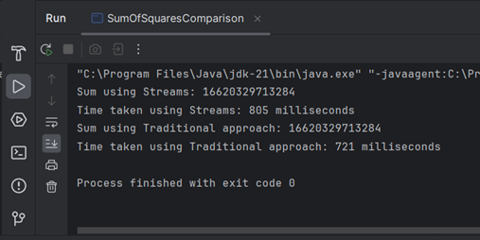
Streams : Code Performance
Fig a) : Output
Code files are attached for reference.

Slide 18
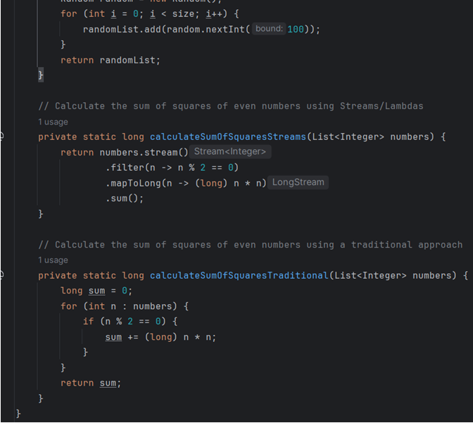
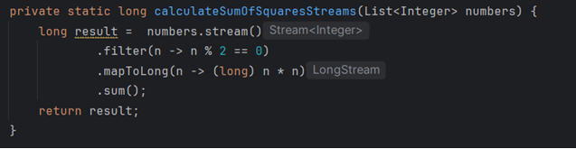
Traditional approach : Code
Streams : Code
Code files are attached for reference.

Slide 19
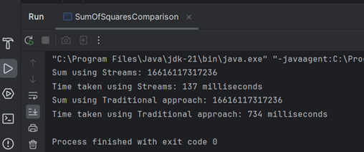
Fig b) : Output
Code files are attached for reference.
Note: Time taken using the traditional approach and streams is different in Fig a) & Fig b).

Slide 20
Reason behind Streams are
Faster.

Slide 21
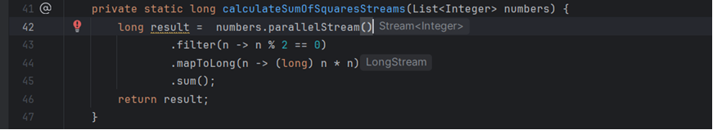
Parallel Streams
Code files are attached for reference.
Notes :
.parallelStream() is used to divide the large datasets into parallel stream pipelines. They enable parallel processing of elements in a collection, dividing the workload among multiple threads.

Slide 22
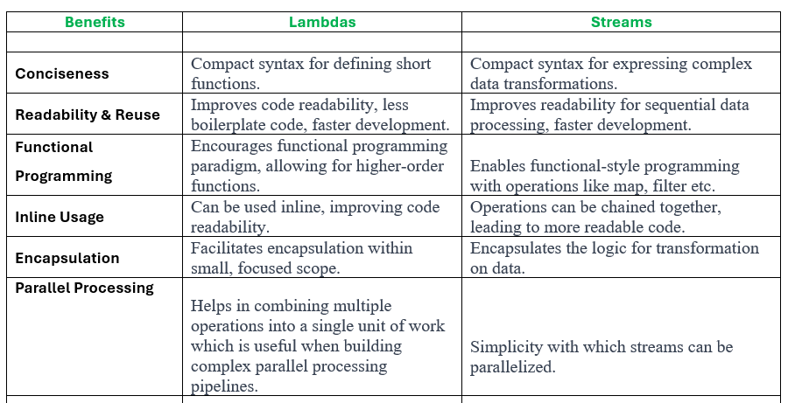

Slide 23
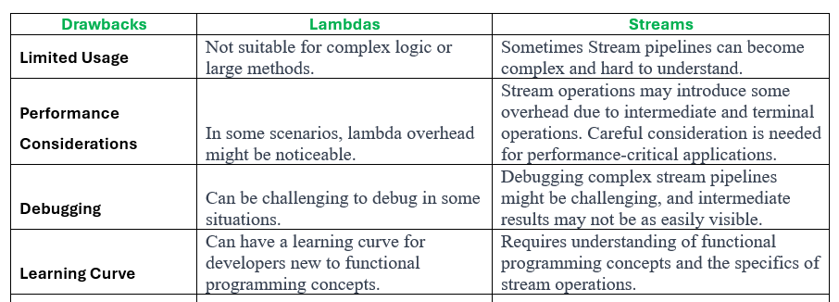

Slide 24
Scope of Functional programming in Java.

Slide 25
Scope of Functional Programming in Java :
1. Functional Interfaces:
Java provides functional interfaces like ‘java.util.function.Functions’ and ‘java.util.function.BiFunction’ , allowing functions to be treated as first-class citizen.
2. Lambda Expressions:
Lambda expressions facilitate concise representation of anonymous functions, enabling easier implementation of functional interfaces.
3. Function Chaining and Composition:
Functional interfaces support method chaining and composition through methods like ‘andThen()’ and ‘compose()’, enabling the creation of function pipelines.
4. Partial Application and Currying:
Although not directly supported in Java, partial application and currying can be implemented manually using lambda expressions and functional interfaces, allowing for the creation of specialized functions with fewer parameters
5. Stream API:
Java's Stream API enables functional-style operations on collections, allowing for declarative
processing of data such as mapping, filtering, and reducing elements.

Slide 26
Limitations

Slide 27
Limitations of Functional Programming in Java :
1. Lazy Evaluation:
Java lacks built-in support for lazy evaluation, which can lead to memory-related issues when dealing with potentially infinite data structures.
2. Optimizations:
Unlike dedicated functional languages, Java may not optimize functional constructs as efficiently due to its multi-paradigm nature.
3. Recursion:
Java may not handle deep recursion well due to stack limitations, leading to stack overflow errors.
4. Performance and Security:
Unbounded recursion in Java can lead to performance issues and security vulnerabilities such as stack overflow errors.

Slide 28
References :
1. Pandey, P. (2020, January 21). Elements of Functional Programming in Python. Medium. https://towardsdatascience.com/elements-of-functional-programming-in-python-1b295ea5bbe0
2. Java Lambda Expressions. (n.d.). Www.w3schools.com.
https://www.w3schools.com/java/java_lambda.asp
‌3. Vo, K. (2019, May 12). Summary Knowledge about Functional Programming For Oracle Professional Java SE 8(Part 1). Medium.
https://medium.com/@vckhanhitiu1/summary-knowledge-about-functional-programming-for-oracle-professional-java-se-8-part-1-12d8f5f4dd4c
‌4. Java 8 Stream Tutorial. (2021, July 28). GeeksforGeeks.
https://www.geeksforgeeks.org/java-8-stream-tutorial/
5. Advantages of Lambda Expression in Java 8 - Javatpoint. (n.d.). Www.javatpoint.com. https://www.javatpoint.com/advantages-of-lambda-expression-in-java-8
‌
6. ChatGPT. (n.d.). Chat.openai.com. Retrieved February 8, 2024, from
https://chat.openai.com/share/964cb842-71f5-4239-8487-a989825e0099
‌

Slide 29
References :
6. ChatGPT. (n.d.). Chat.openai.com. Retrieved February 8, 2024, from
https://chat.openai.com/share/3913193a-a1de-492b-95a7-628276e13f27
7. Functional Programming in Java. (2023, March 14). FreeCodeCamp.org. https://www.freecodecamp.org/news/functional-programming-in-java/
8. The Cafes» Why Functional Programming in Java is Dangerous. (n.d.). Retrieved February 8, 2024, from https://cafe.elharo.com/programming/java-programming/why-functional-programming-in-java-is-dangerous/
‌

